Slide 1
Loan Status Prediction Machine Learning
CHIGURUMAMIDI MADHUKAR
100522862018

Slide 2


Slide 3
Introduction
Loans are the core business of banks. The main profit comes directly from the loan’s interest. The loan companies grant a loan after an intensive process of verification and validation.
However, they still don’t have assurance if the applicant is able to repay the loan with no difficulties. In this tutorial, we’ll build a predictive model to predict if an applicant is able to repay the lending company or not. We will prepare the data using Jupyter Notebook and use various models to predict the target variable.

Slide 4
Language
We will be using Python for this course along with the below-listed libraries
1.Python
2.Numpy
3.Pandas
4.Seaborn
5.sklearn

Slide 5
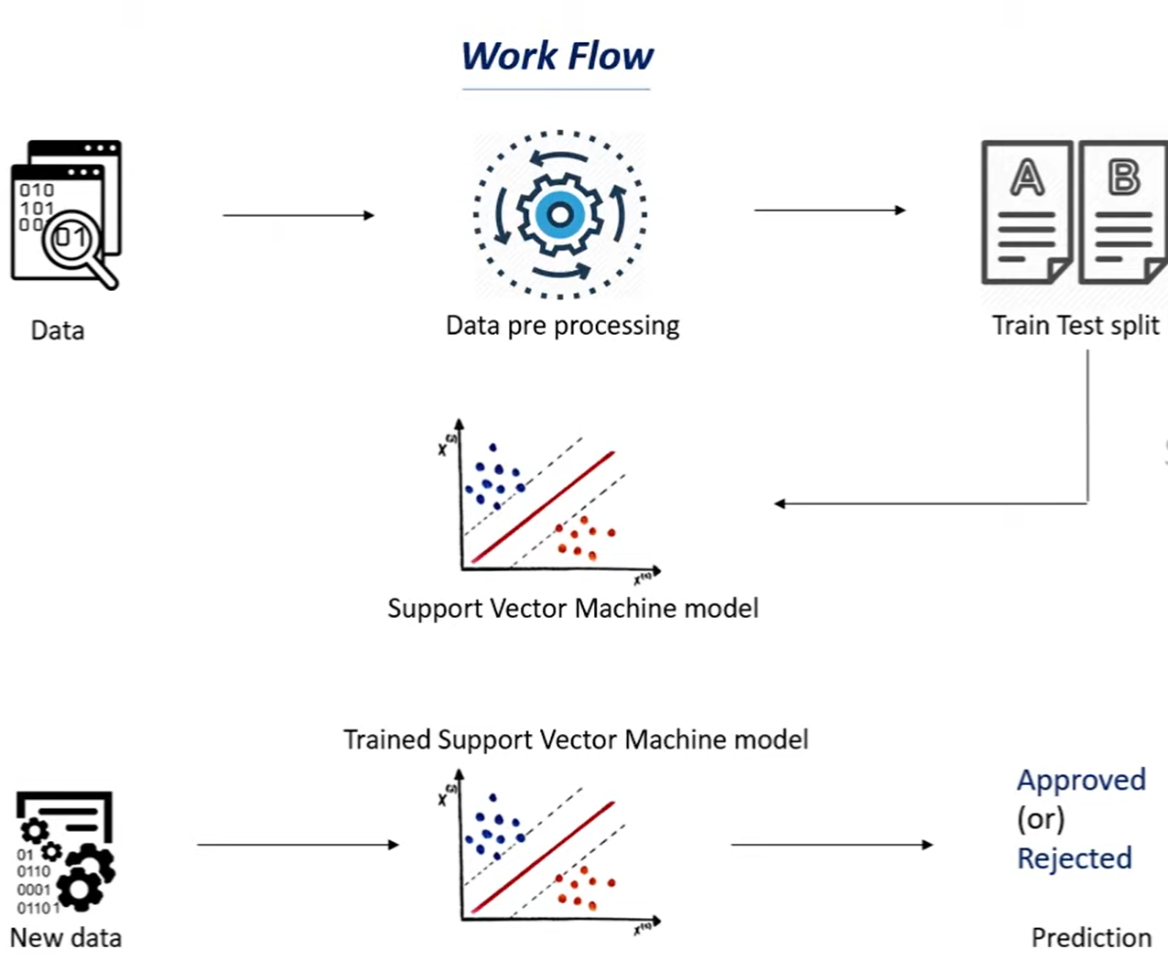

Slide 6
Data
For this problem, we have three CSV files: train, test, and sample submission.
Train file will be used for training the model, i.e. our model will learn from this file. It contains all the independent variables and the target variable.
Test file contains all the independent variables, but not the target variable. We will apply the model to predict the target variable for the test data.
Sample submission file contains the format in which we have to submit out predictions

Slide 7
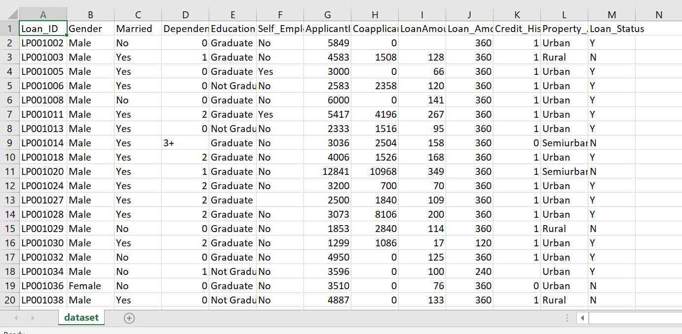

Slide 8
Model Building
Logistic Regression: Logistic Regression is a classification algorithm. It is used to predict a binary outcome (1 / 0, Yes / No, True / False) given a set of independent variables.
Support Vector Mchine: Support vector machines (SVMs) are a set of supervised learning methods used for classification, regression and outliers detection.
Seaborn: Seaborn is a Python data visualization library based on matplotlib. It provides a high-level interface for drawing attractive and informative statistical graphics.

Slide 9
Applications
Finance company deals in all loans. They have presence across all urban, semi urban and rural areas. Customer first apply for a loan after that company validates the customer eligibility for loan.
The Company wants to automate the loan eligibility process (real time) based on customer detail provided while filling online application form. These details are Gender, Marital Status, Education, Number of Dependents, Income, Loan Amount, Credit History and others. To automate this process, they have given a problem to identify the customers segments, those are eligible for loan amount so that they can specifically target these customers.

Slide 10
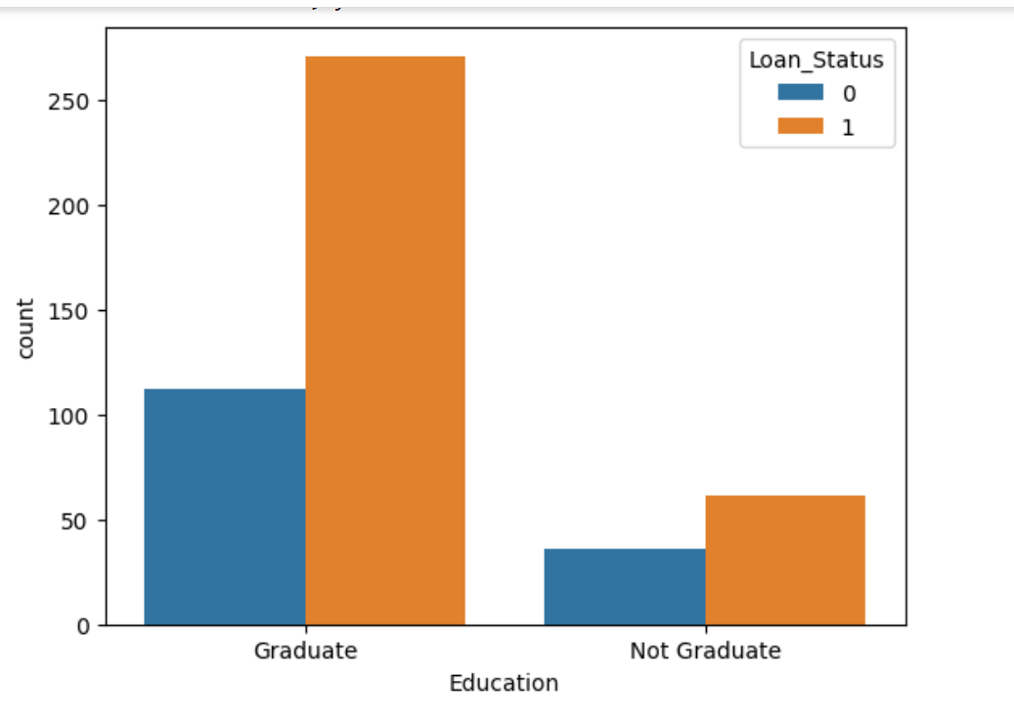

Slide 11
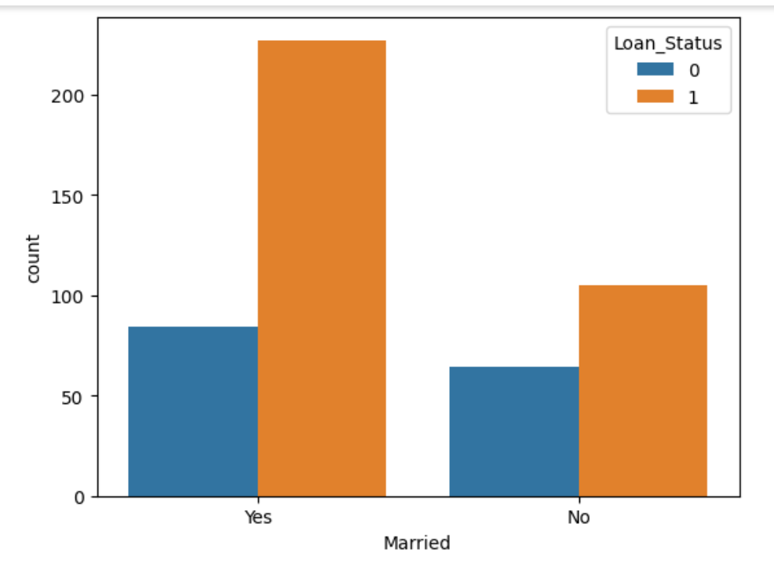

Slide 12
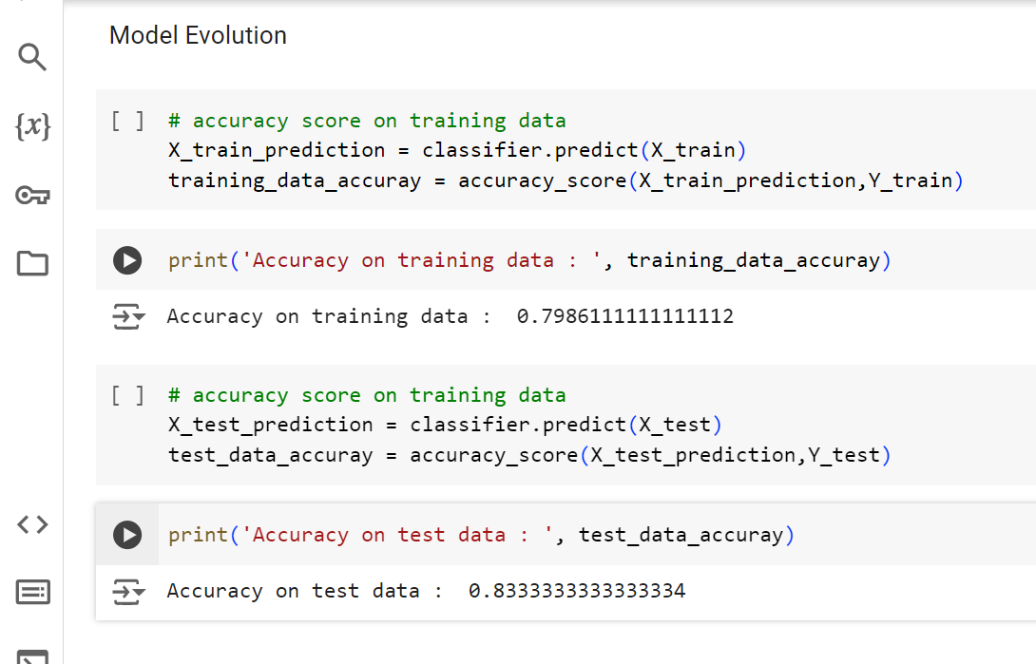

Slide 13
Conclusion
In this project We’ve gone through a good portion of the data such as preprocessing and Train test split and we’ve used essential classification models such as Logistic regression , Support Vector Machine, Seaborn.
It includes mathematical techniques and processes that are applied to historical data to study correlations, identify trends and predict possible outcomes by quantifying the uncertainty and the characteristics of the variation to improve accuracy from train data.

